Slide 1
Surface Mounting Devices
MercedEnergy.com
12-27-2018
Soldering
https://github.com/MercedEnergy/Soldering

Slide 2
SMD & SMT
Surface Mounted Devices
Placed directly on the surface. Lie on PCB
Generally Done By a Machine
Can be done with a soldering iron
Small Surface Mounted Technology

Slide 3
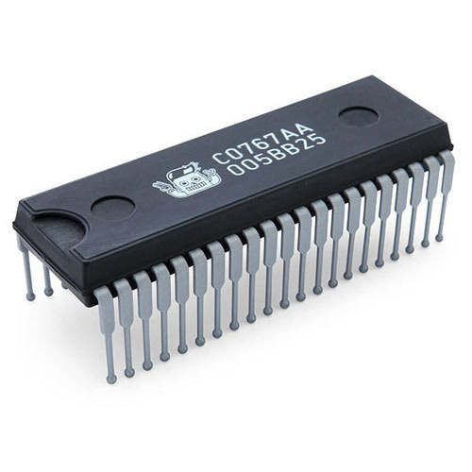
Integrated Circuits
“an electronic circuit formed on a small piece of semiconducting material, performing the same function as a larger circuit made from discrete components.”
Cheaper, faster, and very small.
Difficult to handle.

Slide 4
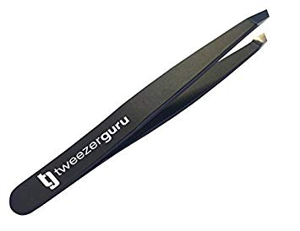
Tweezers
When dealing with very small components.
Straight or Curved tip
ESD Electrostatic Discharge safe and non magnetic

Slide 5
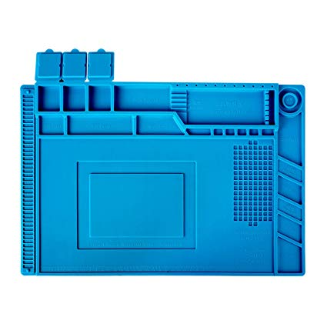
Silicone Mat
Can help you organize.
Can handle high heats.
Prevents shorts
Prevents damage to components

Slide 6
Thank You!
Ramiro Gonzalez
ramirogonzalez@mercedenergy.com

Slide 7
Sources
Vinck, Marc De. Getting Started with Soldering: a Hands-on Guide to Making Electrical and Mechanical Connections. Maker Media, 2017.

